Slide 1
BIOMEDICAL IMAGING (ECE 1023) PROJECT REVIEW-3 TOPIC: DIGITAL SUBTRACTION ANGIOGRAM IMAGE ANALYSIS
BY:
AMISH SHRIVASTAVA -18BML0014
PIYUSH GUPTA -18BML0027
SUKARN PAHUJA - 18BML0048

Slide 2
INTRODUCTION
Digital subtraction angiography (DSA) is a fluoroscopic technique used extensively in interventional radiology for visualising blood vessels. Radiopaque structures such as bones are eliminated ("subtracted") digitally from the image, thus allowing for accurate depiction of the blood vessels.
Helps to detect a problem with blood flow. The procedure involves inserting a catheter (a small, thin tube) into an artery in the leg and passing it up to the blood vessels in the brain. A contrast dye is injected through the catheter and X-ray images are taken of the blood vessels.

Slide 3
PROJECT DETAILS:

Slide 4

Software details:
SOFTWARE USED : MATLAB 2020R
TOOLBOX USED: IMAGE PROCESSING TOOLBOX
TECHNIQUE USED: PARAMETRIC COLOR CODING

Slide 5
INPUTS/OUTPUTS:
INPUT TO THE SOFTWARE : It’s a DSA image showing a transverse projection of the vertebrobasilar and posterior cerebral circulation
OUTPUT FROM THE SOFTWARE: A DSA image showcasing veins in a coloured format is produced as output from the software for further and better analysis.

Slide 6
SIGNIFICANCE OF THE technique used:
color-coding of DSA enhanced the conspicuity of findings on DSA images.
It is particularly useful in situations in which there was a complex flow pattern and in evaluation of pre- and posttreatment acquisitions.

Slide 7
RESULTS:

Slide 8
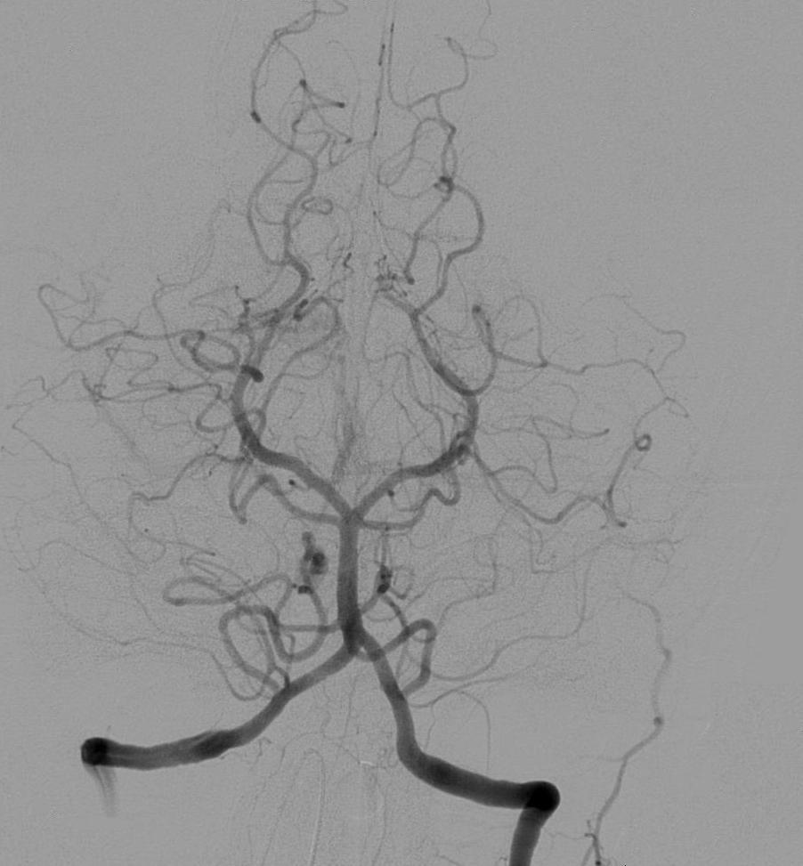
INPUT IMAGE:

Slide 9
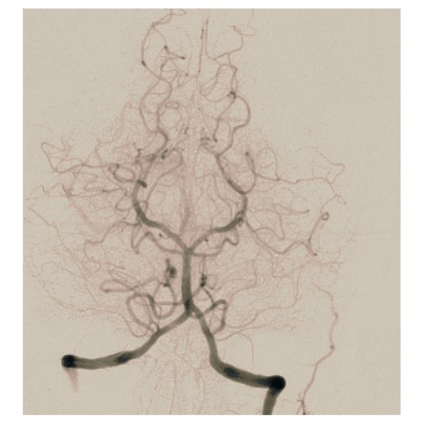
COLOURED IMAGE:

Slide 10
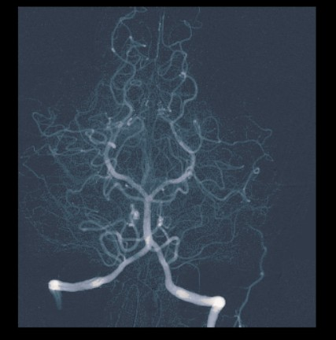
COLOUR CODED DSA IMAGE:

Slide 11
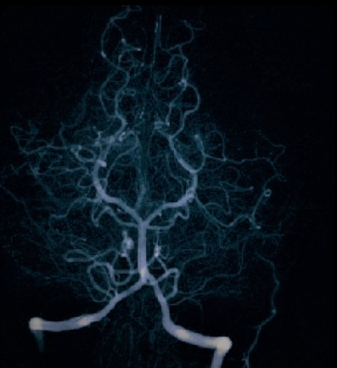
ENHANCED DSA IMAGE

Slide 12
MATLAB CODE: (Coloured image)
clc;
clear all;
close all;
%Reads the input image
k=imread('dsa.jpeg');
[x y z]=size(k);
k=double(k);
for i=1:x
for j=1:y
if k(i,j)>=0 & k(i,j)<50
m(i,j,1)=k(i,j,1)+5;
m(i,j,2)=k(i,j)+10;
m(i,j,3)=k(i,j)+10;
end
if k(i,j)>=50 & k(i,j)<100
m(i,j,1)=k(i,j)+35;
m(i,j,2)=k(i,j)+28;
m(i,j,3)=k(i,j)+10;
End
if k(i,j)>=100 & k(i,j)<150
m(i,j,1)=k(i,j)+52;
m(i,j,2)=k(i,j)+30;
m(i,j,3)=k(i,j)+15;
end
if k(i,j)>=150 & k(i,j)<200
m(i,j,1)=k(i,j)+50;
m(i,j,2)=k(i,j)+40;
m(i,j,3)=k(i,j)+25;
end
if k(i,j)>=200 & k(i,j)<=256
m(i,j,1)=k(i,j)+120;
m(i,j,2)=k(i,j)+60;
m(i,j,3)=k(i,j)+45;
end
end
end
%Plotting of input images.
subplot(2,2,1)
imshow(uint8(k),[]);
title('INPUT DSA IMAGE');
subplot(2,2,2)
imshow(uint8(m),[]);
title('COLOURED DSA IMAGE');

Slide 13
MATLAB CODE: (Colour coded image)
%COLOUR CODED DSA IMAGE
x=imread('output_angio.jpeg');
r(:,:,:)=255-x(:,:,:);
subplot(2,2,3)
imshow(r);
title(“COLOUR CODED DSA IMAGE");

Slide 14
MATLAB CODE: (ENHANCED DSA image)
%ENHANCED DSA IMAGE
x=imread("review2_output.jpeg")
z=0.8*(x-55);
subplot(2,2,4)
imshow(z);
title("ENHANCED DSA IMAGE");
%PLOTTING OF IMAGES SEPERATELY
figure;
imshow(uint8(k),[]);
title('INPUT DSA IMAGE');
figure;
imshow(uint8(m),[]);
title('COLOURED DSA IMAGE');
figure;
imshow(r);
title("IMPROVED DSA IMAGE");
figure;
imshow(z);
title("ENHANCED DSA IMAGE");

Slide 15
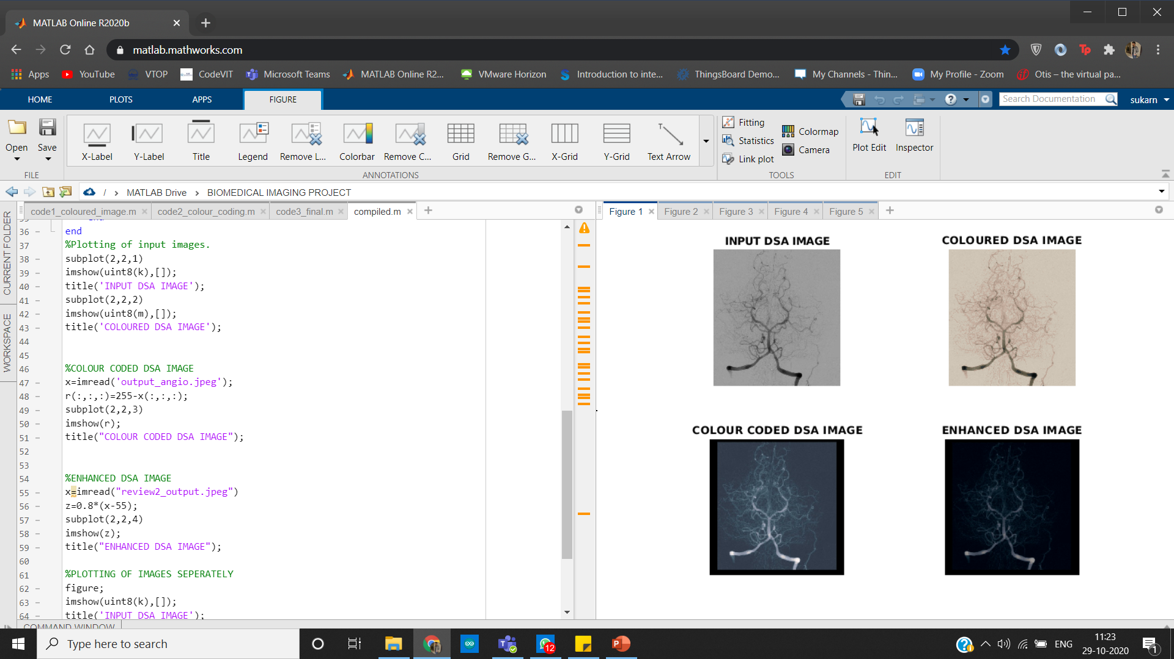
MATLAB OUTPUT: (SUBPLOT)

Slide 16
CONCLUSION
COLOUR CODING: colour coding was done successfully and it becomes easier to analyse the complex flow patterns
Noise Reduction: appropriate functions was used to remove noise and make the visibility of veins more clear and brighter.
Image Enhancement: The contrast and the brightness level of the image was improved for better image quality.

Slide 17
THANK YOU

